Slide 1

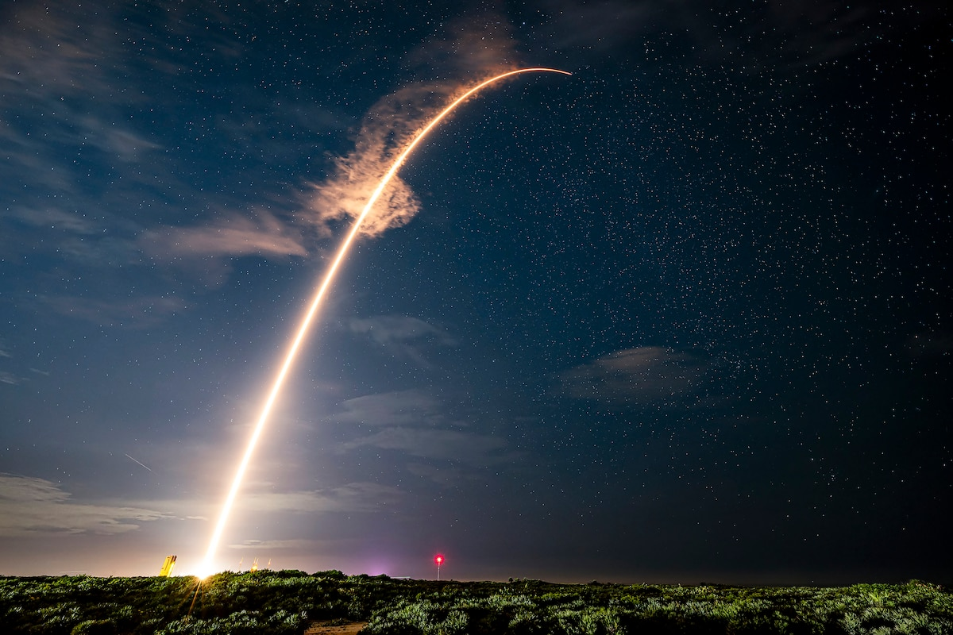
SpaceX Falcon 9 first stage Landing Prediction
Data Science Capstone
Brian Bulowicz
May 2026
https://github.com/bjbci/data_science_capstone/tree/main

Slide 2



OUTLINE
Executive Summary
Introduction
Data collection and data wrangling methodology
EDA and interactive visual analytics methodology
Predictive analysis methodology
EDA with visualization results
EDA with SQL results
Interactive map results using Folium
Plotly Dash dashboard results
Predictive analysis (classification) results
Conclusion
Appendix

Slide 3
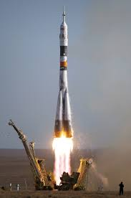

EXECUTIVE SUMMARY
Data Analysis performed on available data to predict whether a SpaceX Falcon 9 first stage booster will successfully land.
The cost of a SpaceX launch is much lower than competitors, 62 million USD versus over 165 million USD for competitors.
The main reason for this cost difference is SpaceX ability to reuse first stage boosters of the Falcon 9 rocket.
If a SpaceX Falcon 9 rocket booster fails to successfully land, the launch cost increases significantly.
Several factors were examined using multiple models to determine elements that affect the potential success of a Falcon 9 booster landing.

Slide 4
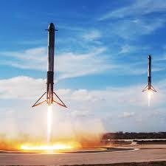

INTRODUCTION
SpaceX is a company founded in 2002 with the aim to make space travel cheaper and more accessible, initially focused on travel to Mars.
SpaceX has since developed a commercial business around using its own rockets to deliver payloads to space.
SpaceX has attempted to reduce the cost of launching rockets by making more components reusable, with a large savings coming from being able to reuse the first stage booster on the Falcon 9 rocket.
SpaceX successfully reusing first stage boosters is factor in being able to deliver payloads to space at a significcantly lower cost than other space agencies.

Slide 5
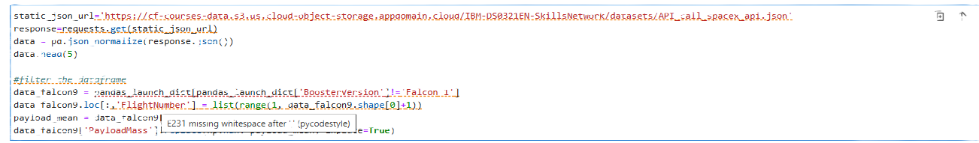
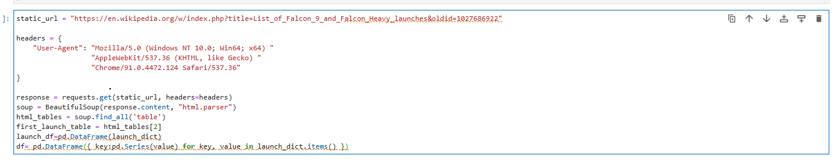
Data collection and data wrangling methodology
Data collected using SpaceX API
Scrape data from webpages using BeautifulSoup
Collect and make sure the data is in the correct format from and SpaceX API using pandas, numpy and python.

Slide 6
EDA and interactive visual analytics methodology
Utilize matplotlib and pandas to display scatterplots and bar charts demonstrating success rate relationship to payload mass, orbit, launch site and flight number.

Slide 7
Predictive analysis methodology
Predictive analysis is performed by
1.Accumulating and processing the data
2. Standardizing the data
3. Split the data into testing and training sets
4. 4reate 4 GridSearchCV objects to model the data
5. Testing the accuracy of each model

Slide 8
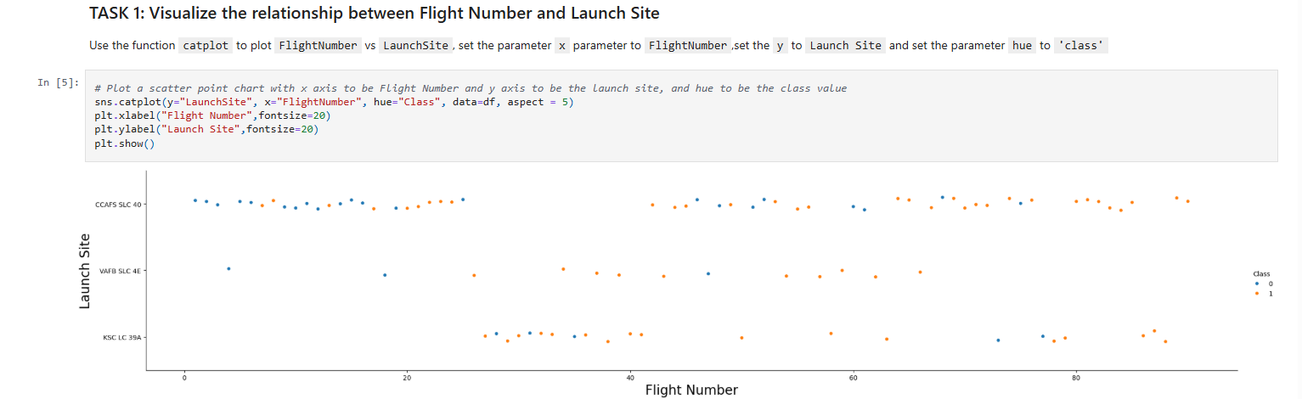
EDA with visualization results (1 of 6)
Exploratory Data Analysis and Feature Engineering

Slide 9
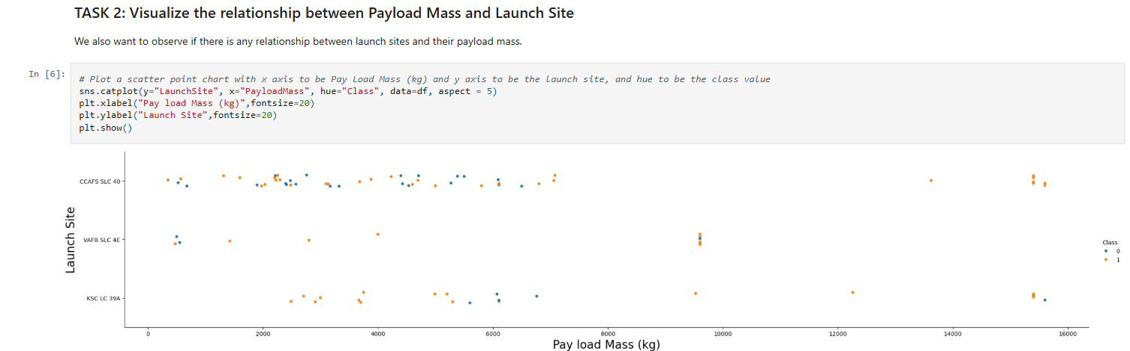
EDA with visualization results slides (2 of 6)

Slide 10
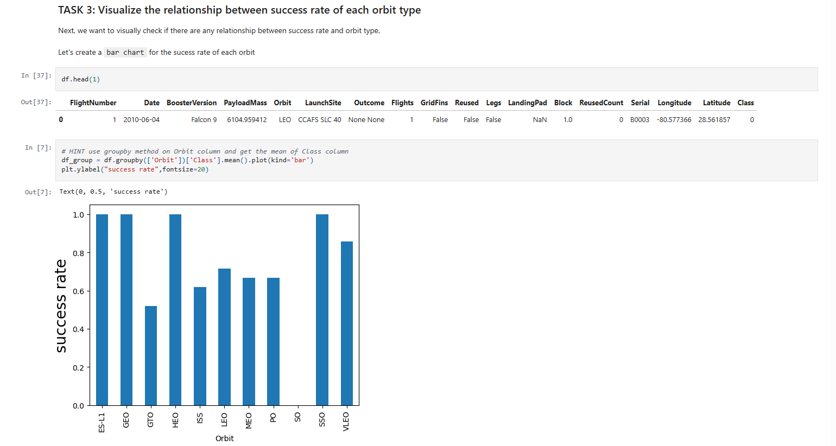
EDA with visualization results slides (3 of 6)

Slide 11
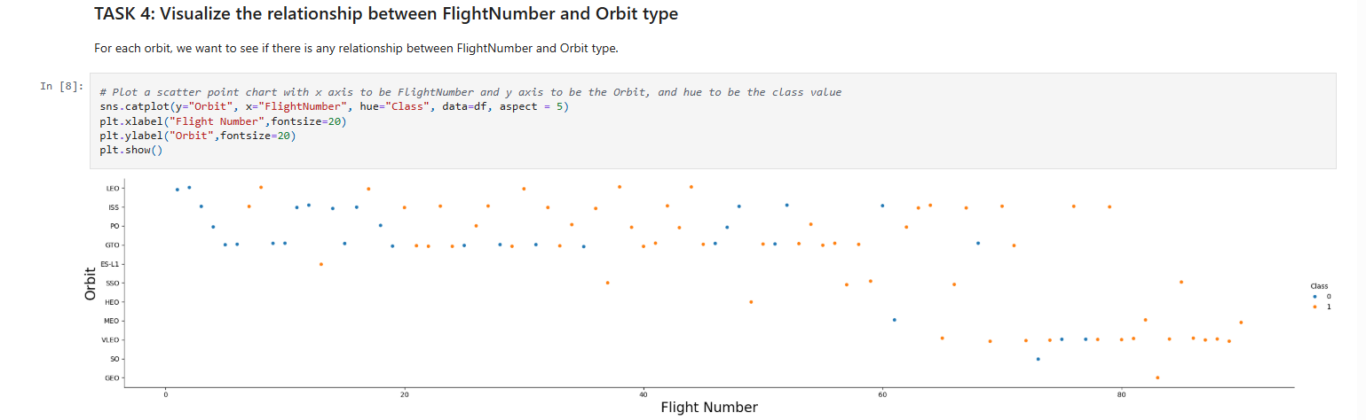
EDA with visualization results slides (4 of 6)

Slide 12
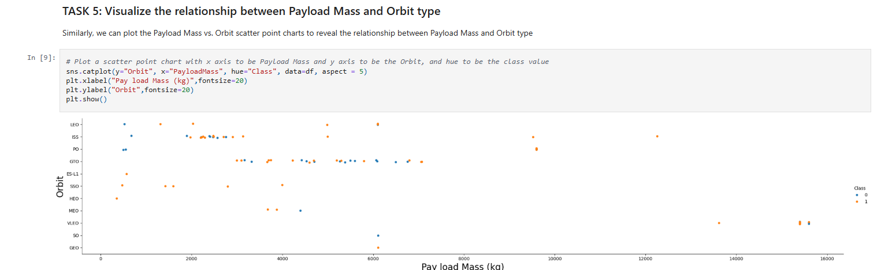
EDA with visualization results slides (5 of 6)

Slide 13
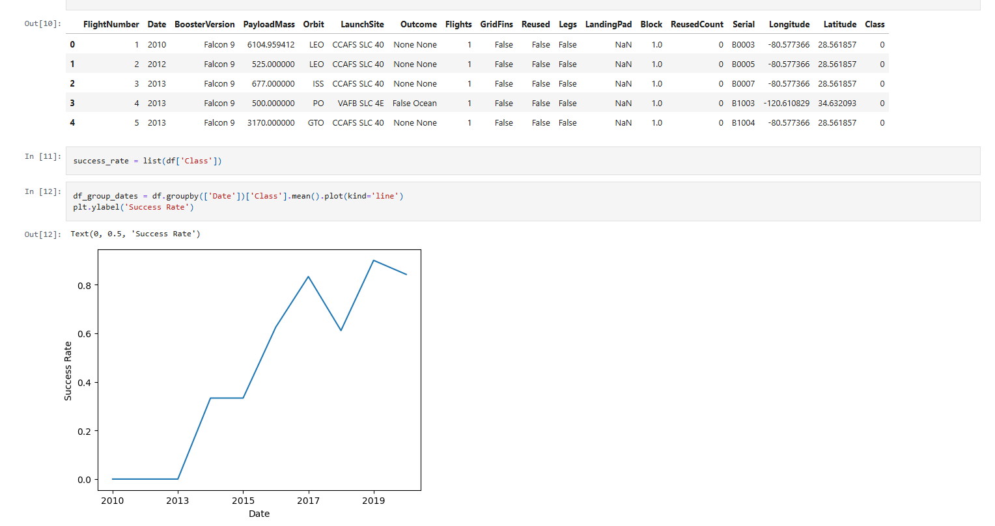
EDA with visualization results slides (6 of 6)

Slide 14
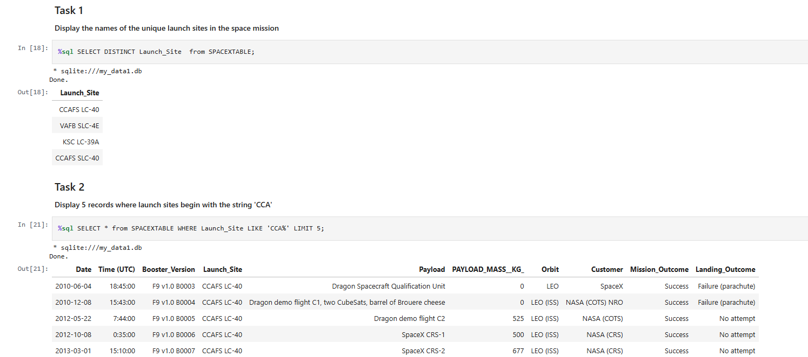
EDA with SQL results (1 of 5)
The dataset includes a record for each payload carried during a SpaceX mission into outer space.
The following SQL queries lead to a table showing types of landing outcomes with number of each

Slide 15
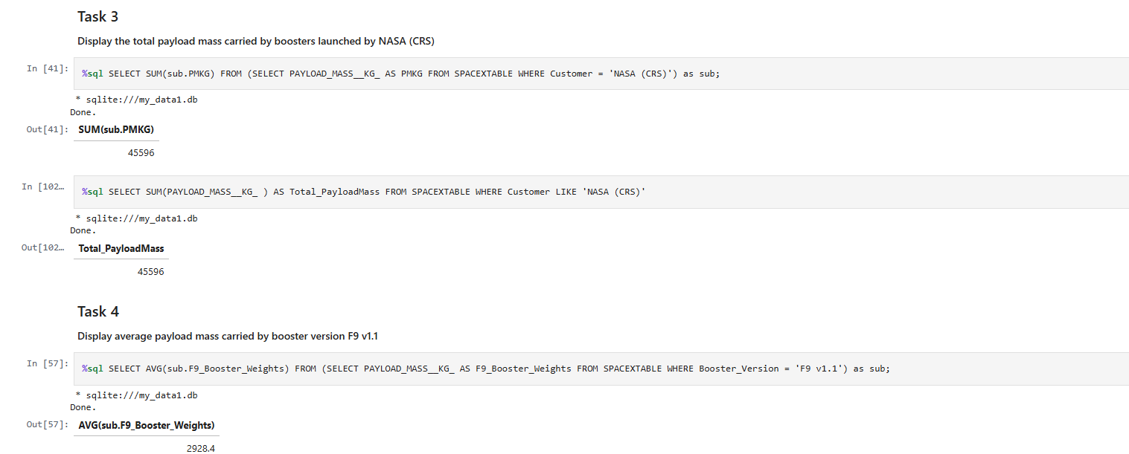
EDA with SQL results (2 of 5)

Slide 16
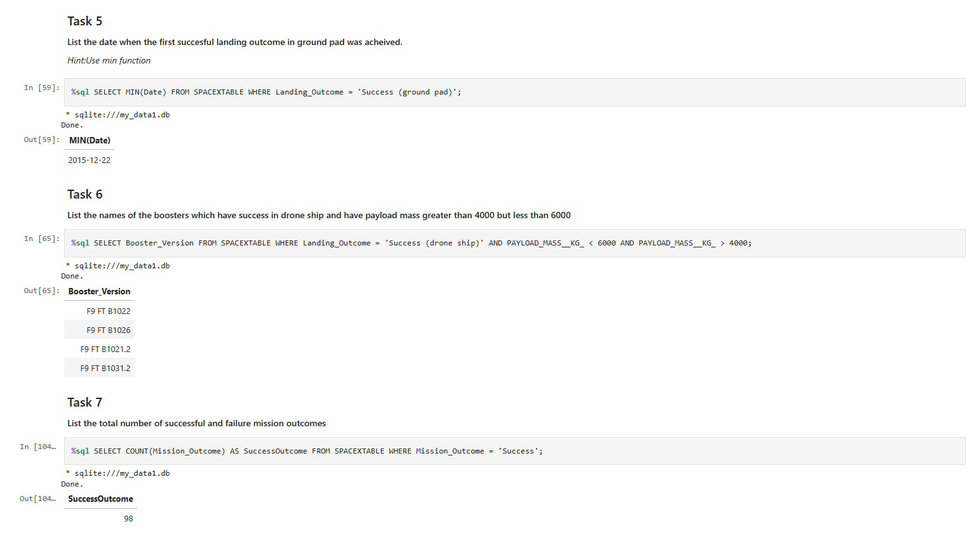
EDA with SQL results (3 of 5)

Slide 17
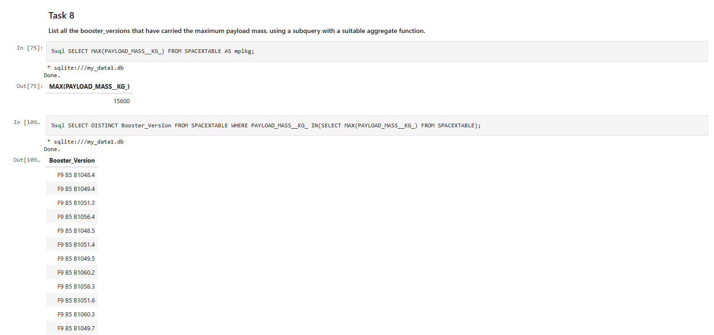
EDA with SQL results (4 of 5)

Slide 18
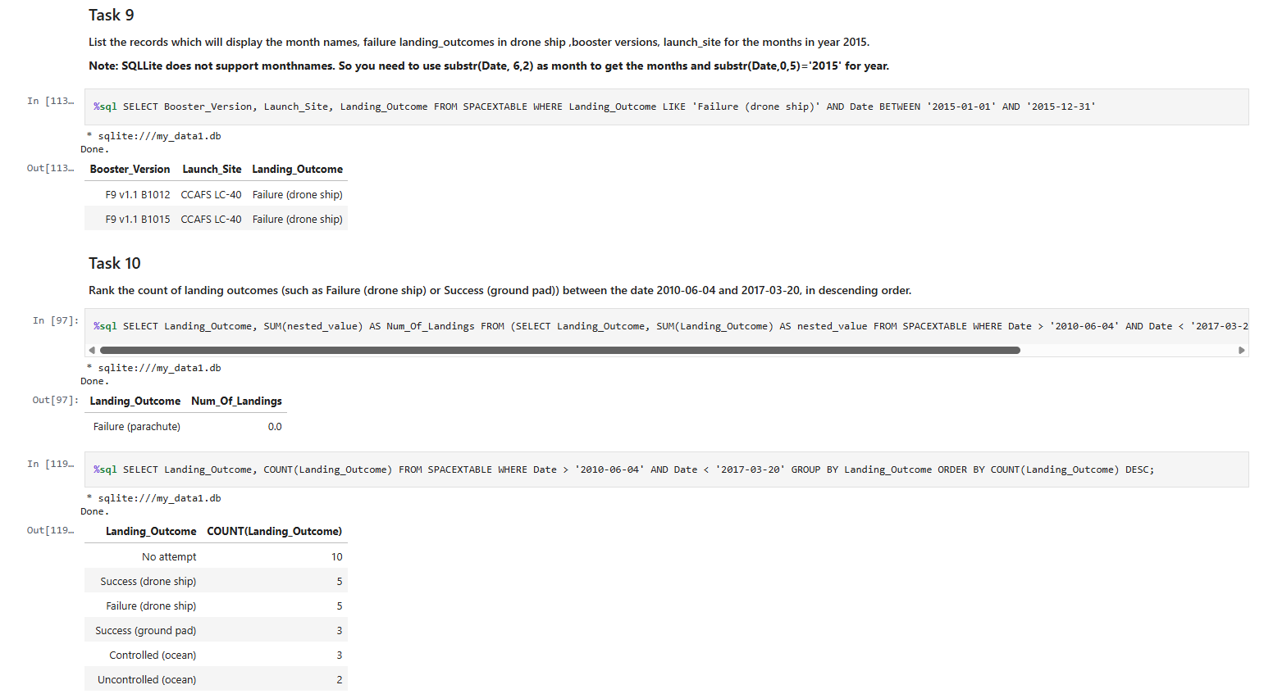
EDA with SQL results (5 of 5)

Slide 19
Interactive map results using Folium (1 of 4)
Using Folium:
Mark all launch sites on a map
Mark the success/failed launches for each site on the map
Calculate the distances between a launch site to its proximities

Slide 20
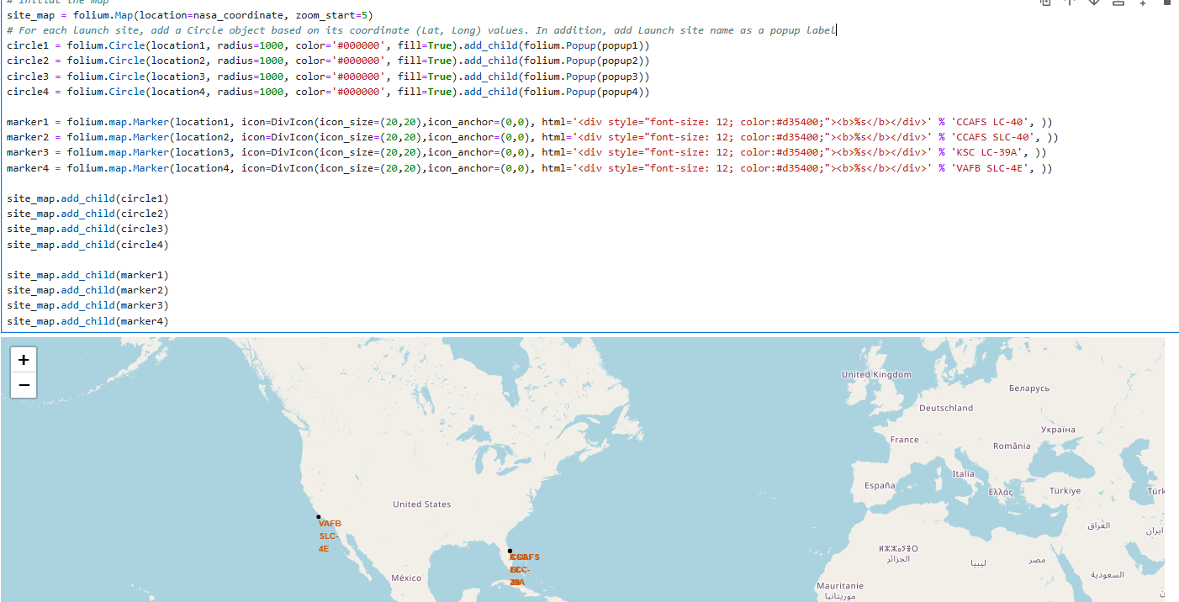
Interactive map results using Folium (2 of 4)
Mark all launch sites on a map

Slide 21
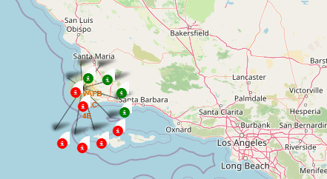
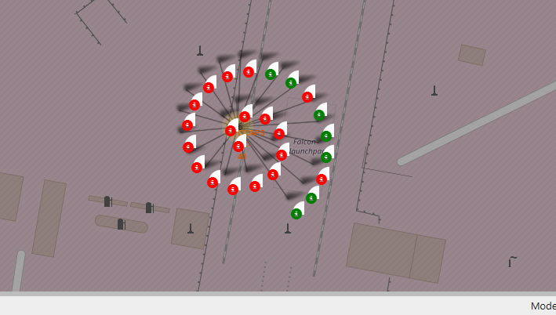
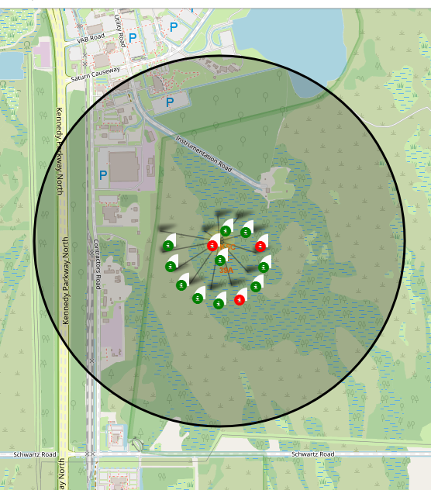
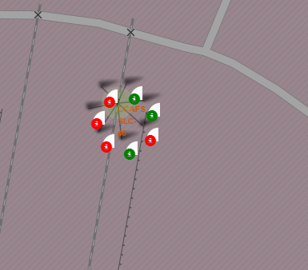
Interactive map results using Folium (3 of 4)​
​
Mark the success/failed launches for each site on the map

Slide 22
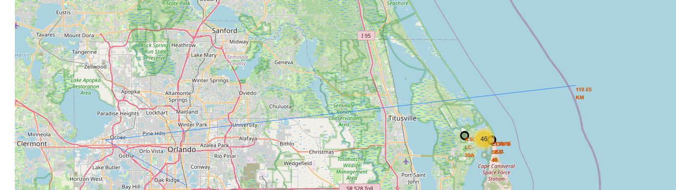
Interactive map results using Folium (4 of 4)​​
​​
Calculate the distances between a launch site to its proximities

Slide 23
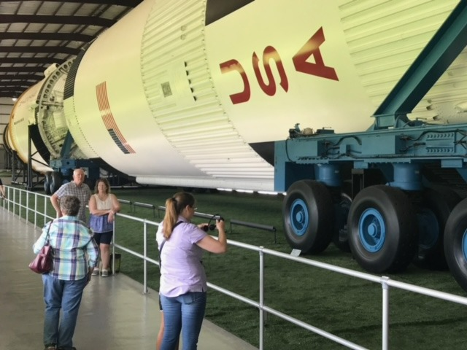

Plotly Dash dashboard results (1 of 6)
Dash application for users to perform interactive visual analytics on SpaceX launch data in real-time to answer the following questions: Which site has the largest successful launches?
Which site has the highest launch success rate?
Which payload range(s) has the highest launch success rate?
Which payload range(s) has the lowest launch success rate?

Slide 24
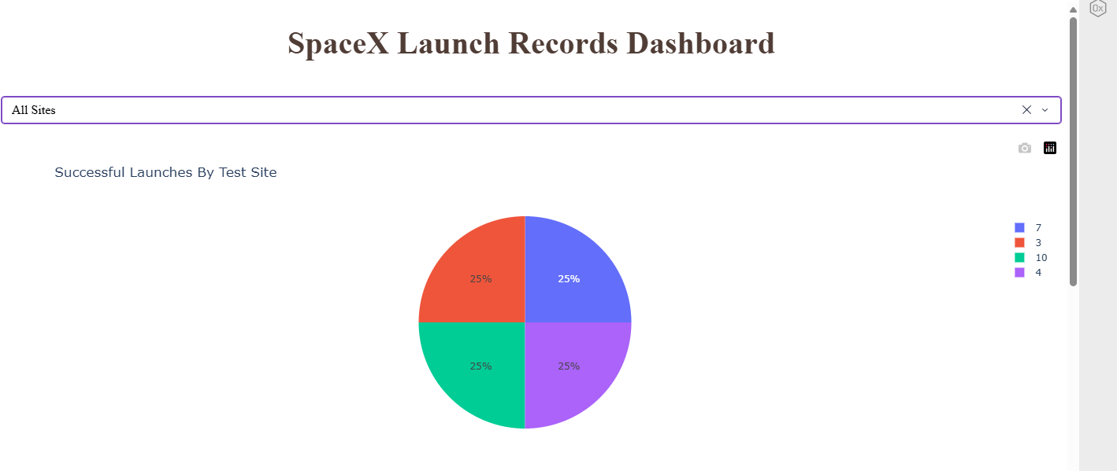
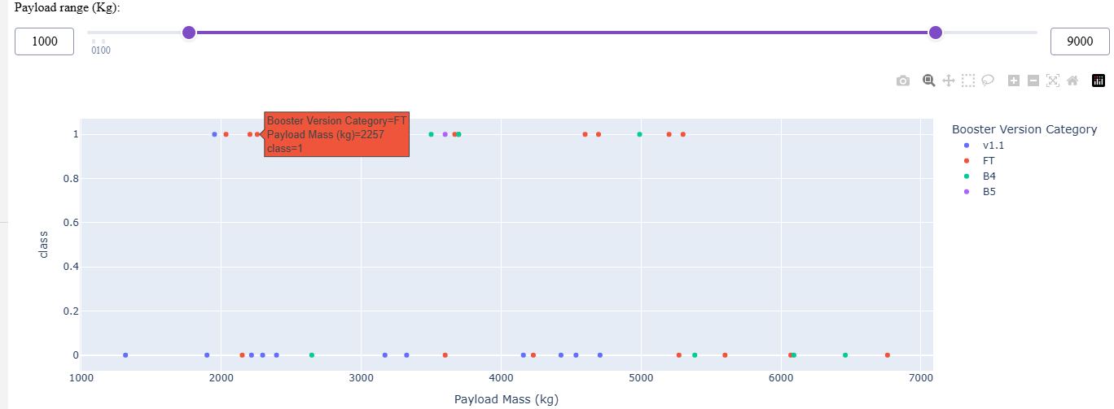
Plotly Dash dashboard results slides (2 of 6)

Slide 25
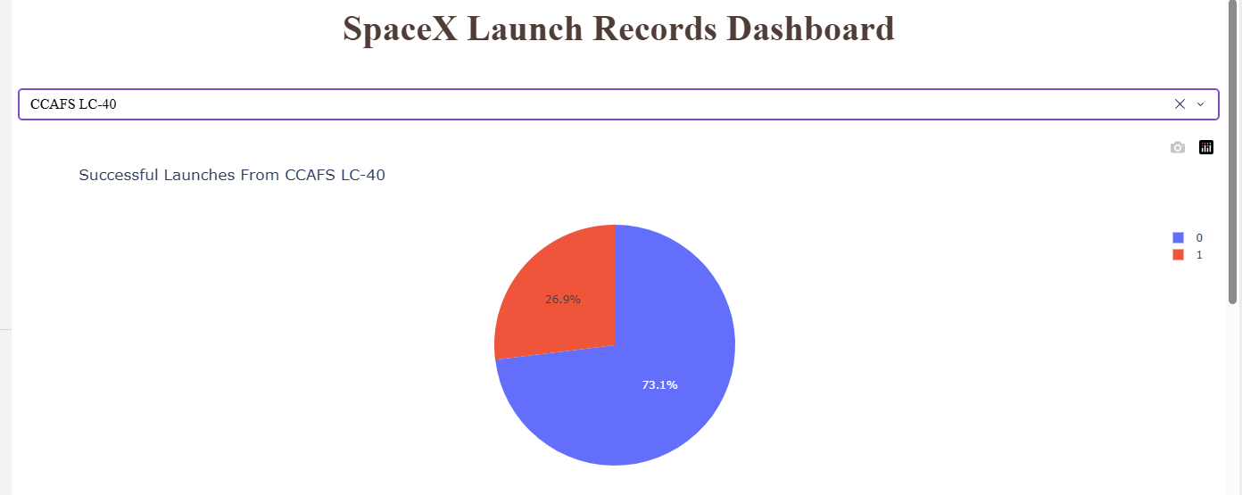
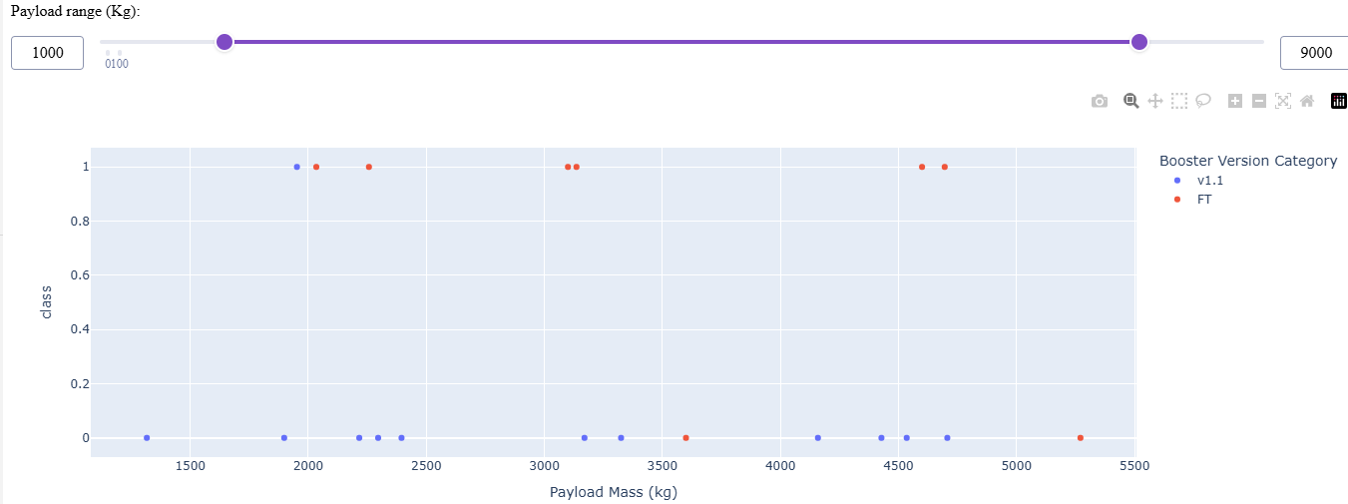
Plotly Dash dashboard results slides (3 of 6)

Slide 26
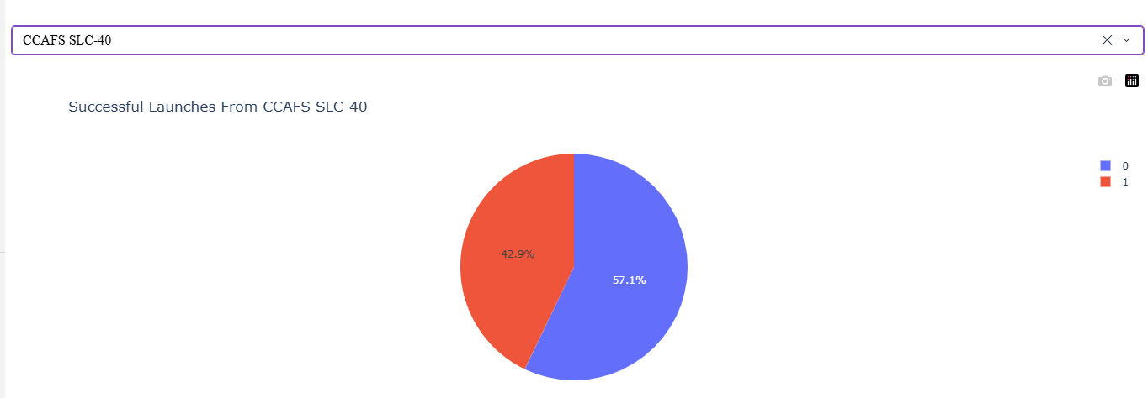
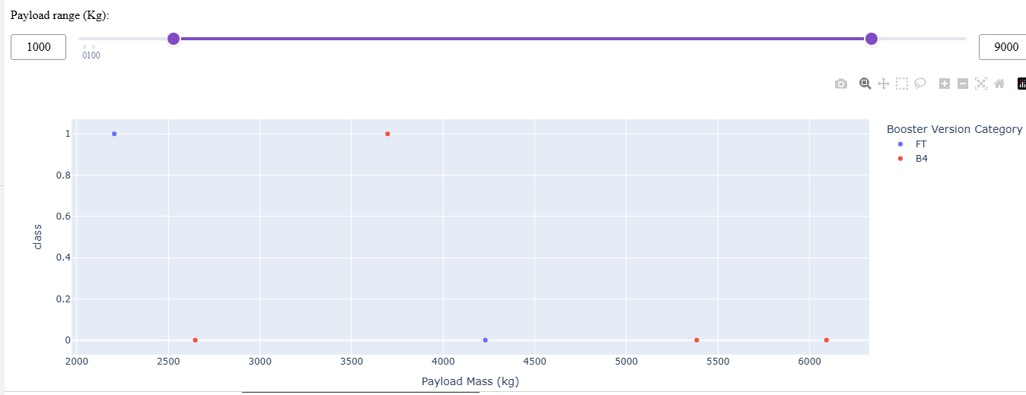
Plotly Dash dashboard results slides (4 of 6)
Dash application for users to perform interactive visual analytics on SpaceX launch data in real-time

Slide 27
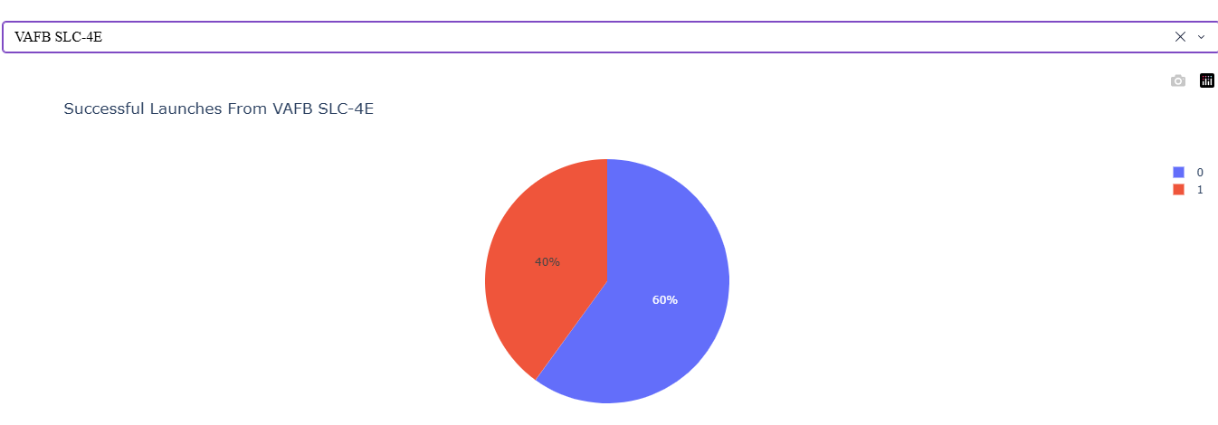
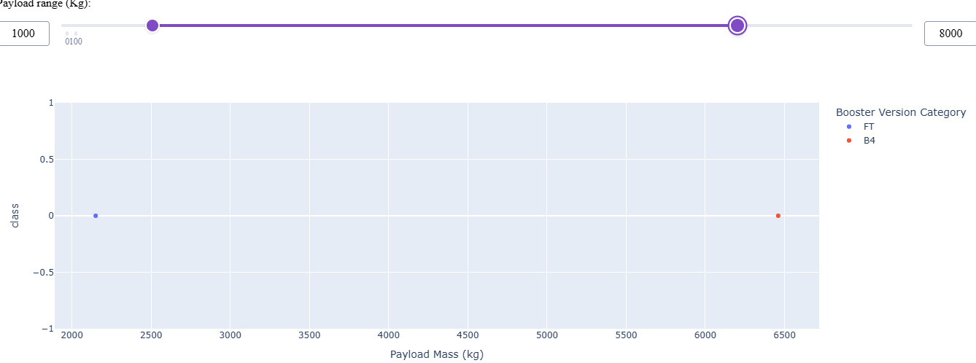
Plotly Dash dashboard results slides (5 of 6)

Slide 28
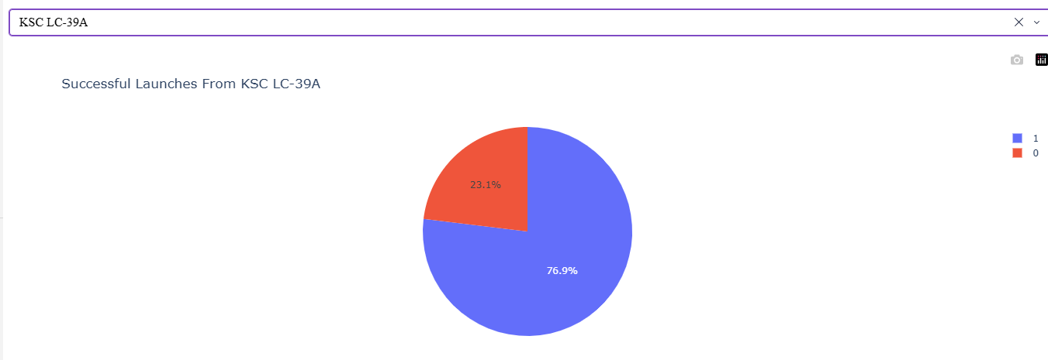
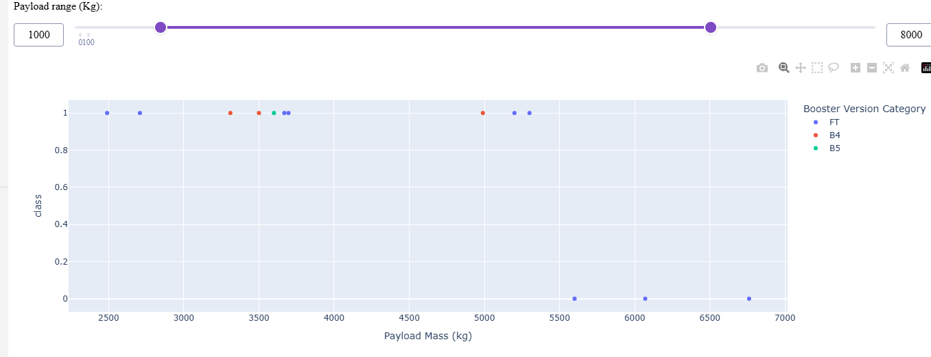
Plotly Dash dashboard results slides (6 of 6)

Slide 29
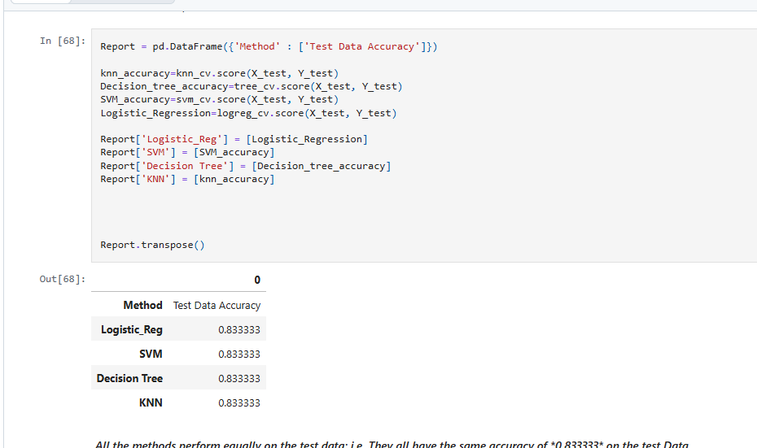
Predictive analysis (classification) results
Screenshot of dashboard tab 1 goes here

Slide 30
Conclusion
There is correlation between frequency of launches and the success of the launches.
The success rate dramatically improved from zero.
The predictive models all performed nearly the same.

Slide 31
appendix/ github link
Github Link Coursera Data Science Capstone:
https://github.com/bjbci/data_science_capstone/tree/main

